Slide 1
Fish Tank
By Mustafe Qaaje

Slide 2
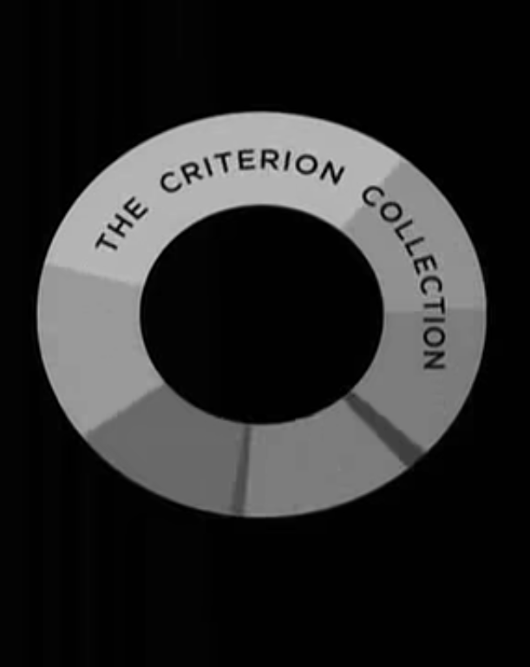

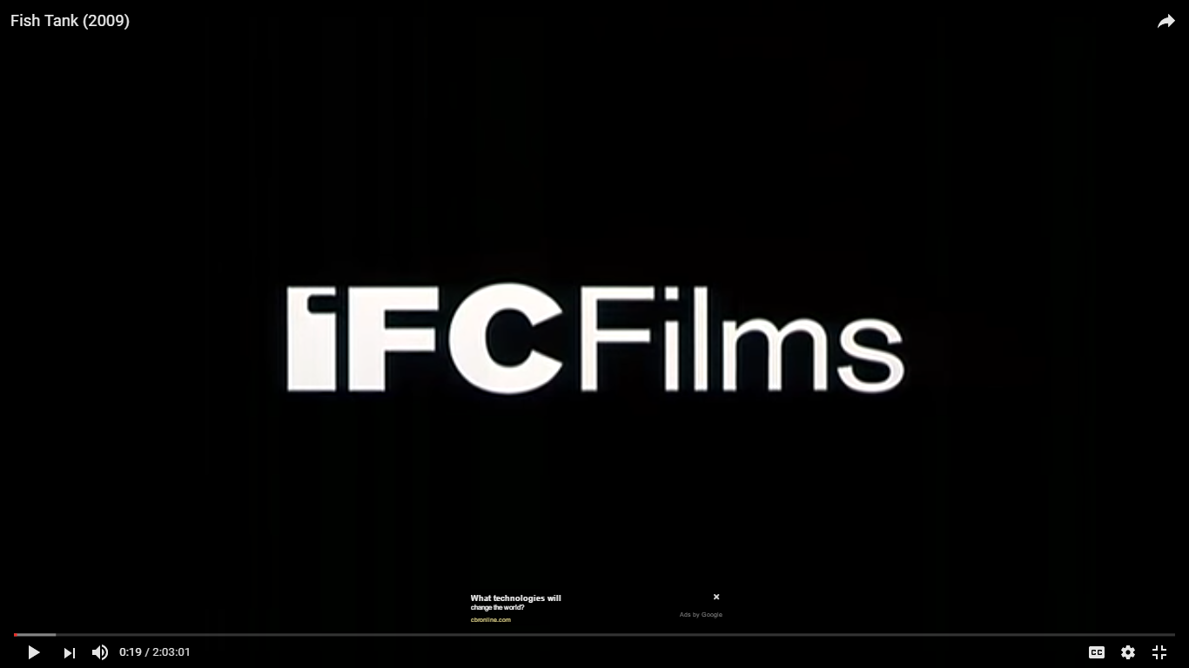

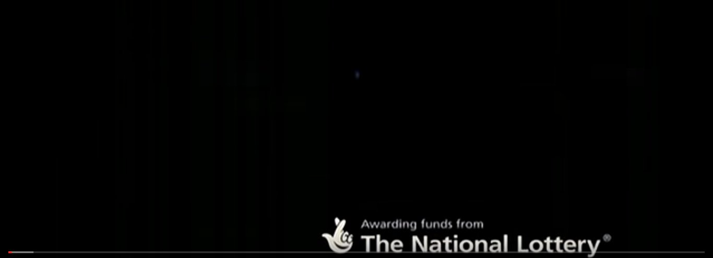
00:00-00:43
In between this time all of the production companies appears in between the 40 seconds. All of the production company logo appears in the centre of the screen. They have decided not to do the same for the last as they have funded the Production. They have inserted the company logo on the bottom left of the screen. Most of these production companies have their own sound which is played when the logo apperes.

Slide 3
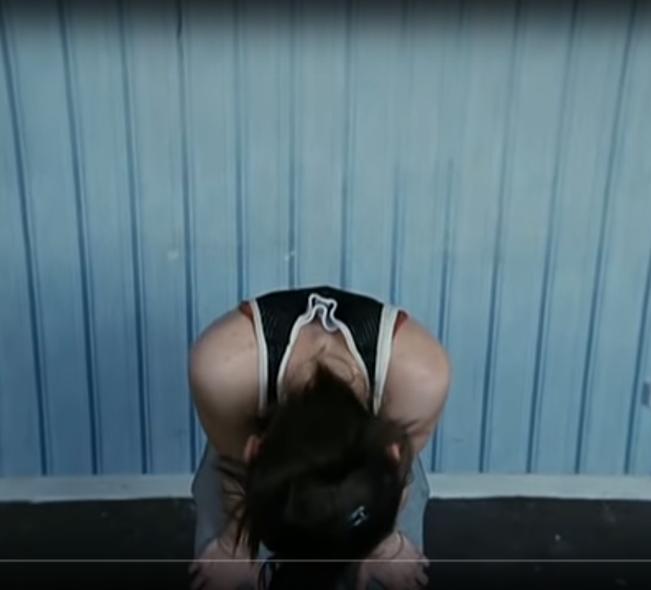
00:43-01:00
In between this time the director has place the main character of the movie in the centre of the screen. This high angle shot is the first view that the audience has on the main character. Due to the high angle of this shot, the surroundings aren't made obvious to the audience which draws their attention away from the setting and the background but towards the girl in the centre of the frame. The diegetic sound of her panting can demonstrate that she's either tired, frustrated or angry.

Slide 4
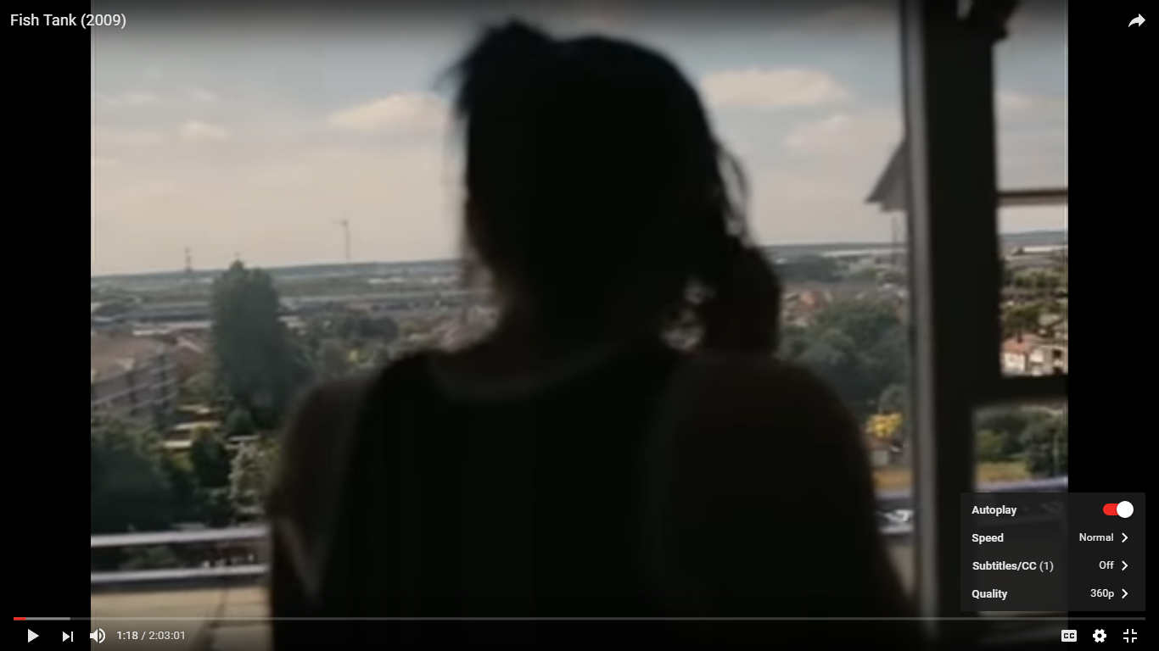
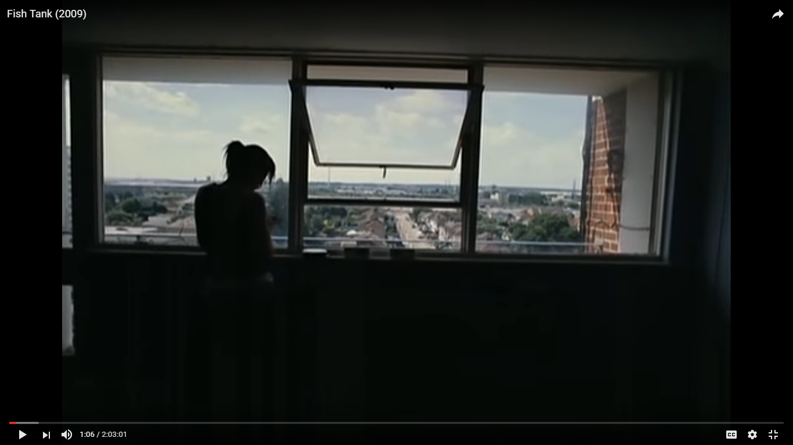
01:00-01:13
This shot shows the girl on the phone at the window. The reason behind having the camera stand at this angle would be to show the audience the setting and where the film is based. From the tall buildings, it's clear that she's most likely living in a flat (as she's high up) which could then imply that she lives on a council estate. The external diegetic sound is of voices talking and traffic to show that it's busy and people shouting.

Slide 5
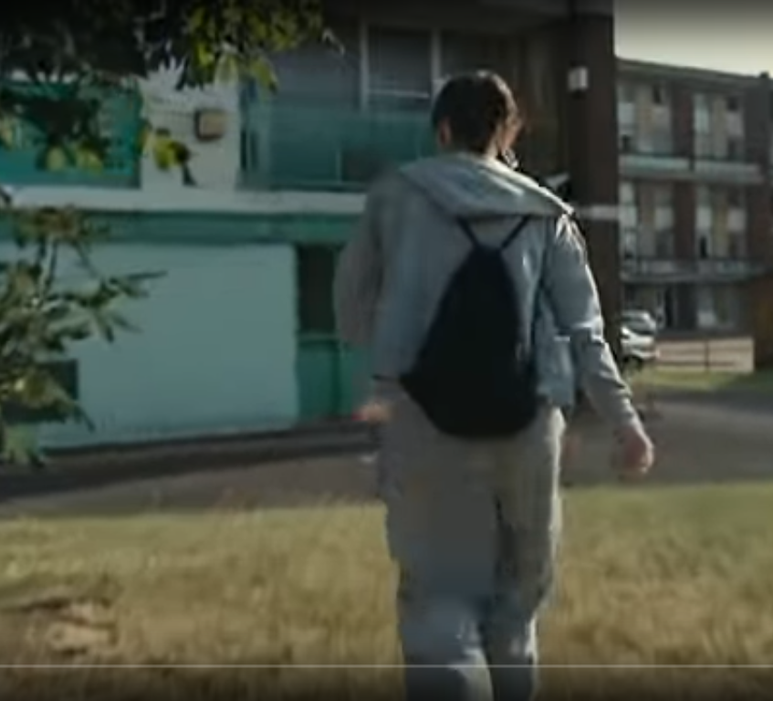
01:15-2:00
Here you see the main character walking through an estate. The director have used a follow shot to monitor the movement of the character. They have also have done this to make the audience feel like they are behind the main character. The sounds you an hear is, cars, people and wind.

